Slide 1




M&A Part 1:
Getting Prepared
for the Deal
Panelists: Mike Basso, Andi Gray,
George Jacobs, and Jason Sharenow

Slide 2

Mergers & Acquisitions
Pt. 1: What has to happen before an acquisition, for both sellers and buyers

Slide 3

Panelists
Moderator: Jason Sharenow – Broadway Elite
Andi Gray – Strategy Leaders
Mike Basso – Leros Point to Point
George Jacobs – Windy City Limousine & Bus

Slide 4

What’s your why?
Why are you pushing for an acquisition?
  Buyers
    Sales Growth
    Customer acquisition
    New market expansion
    New equipment / type of service
  Sellers
    Retirement
    Can’t survive on your own
    Want to move to the next industry / type of service

Slide 5

Preparing for an acquisition
What does a buyer need to have in place, what resources do they need to have when buying a business?

Slide 6
Preparing for an acquisition
Buyer expectations
Seller expectations
What are you looking for from your acquisition
Build a checklist
Have you thought about market timing? When’s the right time to buy?
What is it like to be a seller?
Sell when business is good, get a better result

Slide 7

Preparing for an acquisition
Who’s on your team? – lining up the right professionals up front
Legalities of preparing for the deal; Cleaning up your records
Role of an LOI – letter of intent

Slide 8

Getting your “house” in order
Review your finances and company goals
Is the company profitable?
Are you bankable?

Slide 9

What’s your company’s value?
Both buyers and sellers should get valuations done
Different types of values you can get
  Equity – gift tax, family transfers
    The whole boat, all assets, liabilities, on and off the books
  Asset – purchase from / sale to outsiders
    Seller typically keeps A/R, A/P, excess cash, and is responsible for paying off all loans
    Buyer gets an ongoing company, equipment, phone numbers, customer lists, employees
    Investigate: Client contracts, employee contracts, titles free and clear
  Enterprise – venture investment, value as an ongoing enterprise
  Liquidity – close the doors, assets sold piecemeal, orderly or forced

Slide 10
What’s your company’s value?
What does EBITDA mean?
  Earnings Before Interest Taxes Depreciation & Amortization
What about multiples?

Slide 11
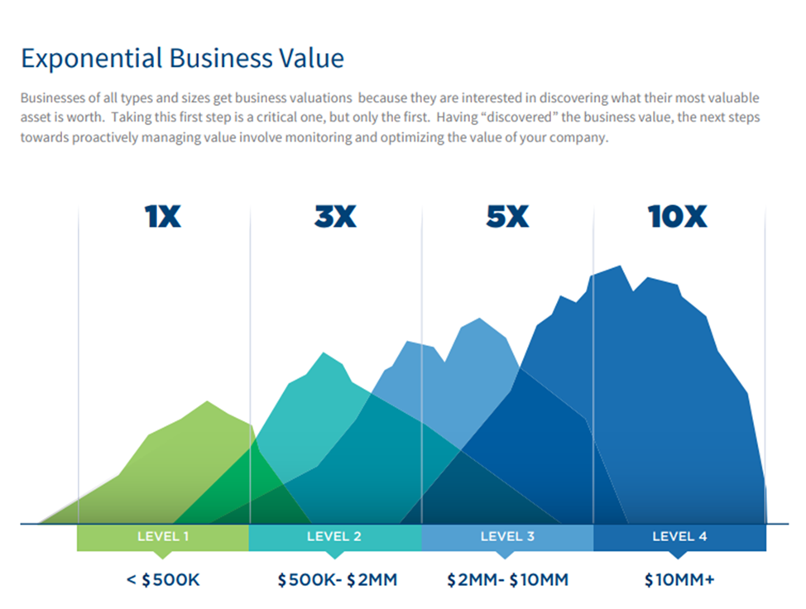
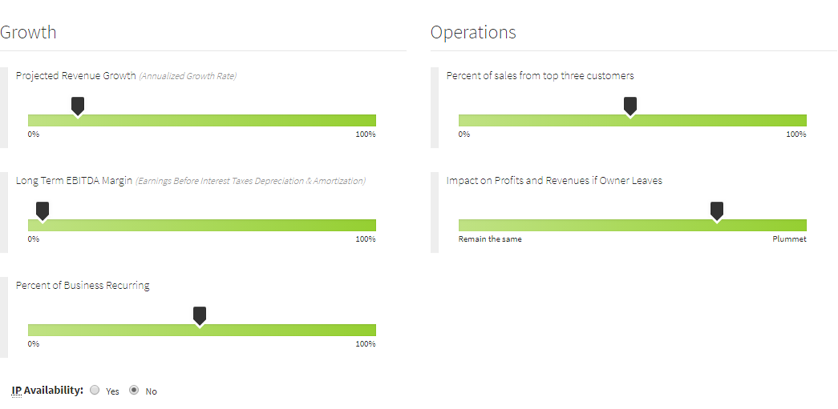
Valuation Influencers

Slide 12

What’s your company’s value?
What markers matter when trying to get the best price for your company?
  Cash on hand
  Assets / Liabilities
  Where’s your A/R sitting – in your res system, or in Quickbooks?
  How are you reporting A/R on your taxes?
  What about the vehicles?

Slide 13
Thank you for joining us!
Come back for Part Two at 1:30 p.m., after getting some
lunch from 12:15-1:15 p.m. in Longhorn on the third floor.

Slide 14
This slide is deliberately blank to separate the two sessions.

Slide 15
M&A Part 2:
The Nuts & Bolts of
Making It Happen
Panelists: Marlene Bartolo, Andi Gray,
Drew Morris, and Jason Sharenow

Slide 16
Mergers & Acqusitions
Pt. 2: Actual deal-making, and the transition after acquisition

Slide 17
Panelists
Moderator: Jason Sharenow – Broadway Elite
Andi Gray – Strategy Leaders
Marlene Bartolo – Bartolo Law
Drew Morris – Nachimas, Morris & Alt

Slide 18

Deal transaction
Who you need on your team:
  Attorney experienced in M&A; accountant; valuation specialist; buy-sell consultant
Understand and be prepared with a valuation, don’t wing it
  What are the right options for both buyer and seller in terms of the best purchase method?
  What should you do if you don’t like the outcome of the valuation?
  What’s normal? When should you walk away?

Slide 19

Structuring the deal – what is/are the right option(s) for you?
Asset vs. Stock and liabilities associated
Extinguishing outstanding liabilities at closing
Selling / buying LP vs. S-Corp. or C-Corp.
Setting up separate deals for separate assets like real estate, vehicles, intellectual property
Legal and tax challenges and opportunities in structuring your acquisition

Slide 20

Post-deal – working out the details
Merging company culture
  Does the culture at one company match up with the other?
Employee management
  Talking to key managers and employees about the acquisition and what that means to them
  Set up time to do interviews with existing team, and review job duties with new employees

Slide 21

Post-deal – working out the details
Strategy & finances
  What happens to the following with you buy/sell a company:
    Cash reserves
    Liabilities
    Accounts receivable

Slide 22

Expectations post-sale
Revenue expectations and accounting for customer loss / gain
Marketing and branding – getting a clear message together
Intellectual property

Slide 23
Thank you for joining us!
Our bonus roundtable session, Making Your Expenses
Work for You, begins right here at 4 p.m.—you won’t
want to miss it!

